Slide 1
Title Slide: Introduction
College Name: S.B Jain Institute Of technology Management and Research
Department Name: The Department of Emerging Technologies
Project Title: Detection of Diabetic Retinopathy Using Machine Learning
Team Members: 1) Ritik Malviya
2) Ruchita Kumbhare
3) Ankush Gupta
4) Sohail Ansari
Guide Name: Ravi Asathi
Date: 5/09/2024

Slide 2
Slide 2:
Introduction
Diabetic Retinopathy (DR) is a severe eye condition caused by high blood sugar levels, primarily affecting individuals with diabetes.
If untreated, DR can lead to blindness, making early detection crucial to prevent vision loss.
Traditional diagnosis involves manual examination of retinal images by ophthalmologists, which is time-consuming and requires specialized expertise.
Machine Learning (ML) and Deep Learning, especially Convolutional Neural Networks (CNNs), are now being used to automate DR detection from retinal images, improving accuracy and efficiency.
These advancements aim to make DR diagnosis more accessible, particularly in regions lacking specialized eye care professionals.
Objectives:
Automate Detection: Develop a system using CNNs and other ML techniques to detect and classify diabetic retinopathy with high accuracy.
Improve Accessibility: Create a scalable solution that can be deployed in remote and underserved areas with limited access to specialized eye care.
Enable Early Intervention: Facilitate early detection of DR to prevent its progression to more severe stages, thereby reducing the risk of blindness.
Key Statistics:
Diabetic Retinopathy is the leading cause of blindness among working-age adults worldwide.
In India around 70 million people are diabetic and each year around 1 million people lose their vision.
In 2021, approximately 529 million people globally were living with diabetes; this number is projected to rise to 1.3 billion by 2050.
In the United States, over 9.6 million people have DR, with around 1.8 million experiencing vision-threatening stages.

Slide 3
Slide 3: Literature Review
Background Information:
Diabetic Retinopathy (DR) is a condition caused by damage to the retina due to high blood sugar levels in diabetic patients.
It progresses through stages, from mild to severe, with the potential to cause blindness if not detected early.
Early detection is crucial to prevent vision loss, highlighting the need for efficient diagnostic methods.
Related Work:
Convolutional Neural Networks (CNNs): CNNs are commonly used in DR detection for their ability to learn features from retinal images, offering high accuracy in diagnosis.
Deep Neural Networks (DNNs): DNNs improve DR classification by handling complex patterns in retinal images, leading to better diagnostic accuracy.
Ensemble Methods: Combining multiple models (ensemble methods) enhances detection accuracy, outperforming individual models.
Siamese CNN Architecture: This method compares images from both eyes using two CNNs, achieving high accuracy in DR detection.
Transfer Learning: Pre-trained models, fine-tuned for DR detection, speed up training and improve accuracy, especially when data is limited.

Slide 4
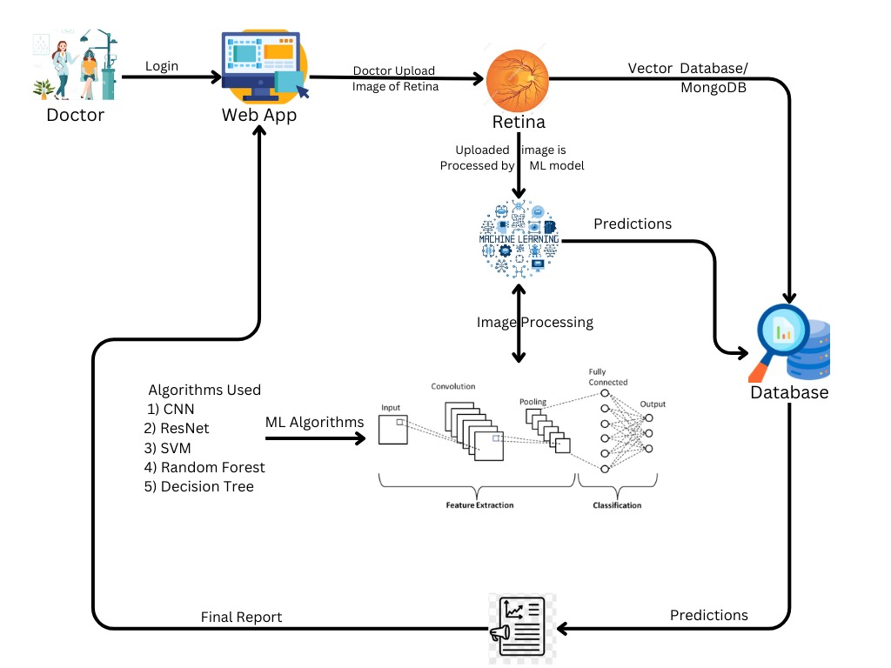
Slide 4: Methodology Approach, Tools and Technologies Used
Fig System Architecture
Tools and Technologies Used
Web Development: HTML, CSS, Java Script, React
Machine Learning: CNN, ResNet50, Random Forest, EfficientNet, SVM
AIP Integration: Flask
Data Base: MongoDB or Vector Data Base

Slide 5
Slide 5: Progress So Far
Completed Tasks:
Project Topic Selection: Chose a project topic with an available dataset online, ensuring feasibility for research paper development.
Data Collection: Gathered relevant datasets needed for model training and testing.
Research Paper Collection: Collected research papers to understand existing methods and approaches in the field.
Base Paper Selection: Selected a key research paper as the foundation for our methodology.
Technology Stack Identification: Identified the necessary tools and technologies (e.g.,RestNet 50, Efficient Net, CNN RNN, etc) to be used in the project.
Documentation Preparation: Prepared project documentation, outlining the objectives, methodology, and timeline.
Milestones Achieved:
Project Topic Selection: Successfully selected the project topic.
Dataset Collection: Completed the acquisition of the required datasets.
Selection of Algorithm for Model: Chose the appropriate algorithms (e.g., CNN, Random Forest) for the predictive model.

Slide 6
Slide 6: Current Status
Ongoing Work:
Developing the Machine Learning Model: Actively working on building and refining the model to accurately detect Diabetic Retinopathy using the selected algorithms.
Challenges Faced:
Finding an Appropriate Dataset: Encountered difficulties in obtaining high-quality medical datasets due to privacy issues and the specific requirements for annotated data.
Selecting the Right Algorithm: Faced challenges in choosing the optimal algorithm that balances accuracy, speed, and computational resources.
Deciding on the Platform for Implementation: Evaluating the best platform for developing and deploying the model, considering factors like computational power, ease of use, and collaboration capabilities.

Slide 7
Slide 7: Future Work
Next Steps:
Improving model accuracy through techniques like transfer learning or ensemble methods.
Setting up the web application framework.
Integrating the machine learning model with the web application.
Fine-tuning the machine learning model for enhanced accuracy.
Enhancing the user interface of the web application.
Deploying the web application for real-world testing.
Timeline:
Provide a detailed timeline of the remaining tasks with expected completion dates.

Slide 8
Slide 8: Conclusion
Project Goal: Enhance the detection of Diabetic Retinopathy (DR) using advanced machine learning and deep learning techniques.
Automation: Aim to automate the DR detection process to increase efficiency and accessibility.
Improved Accuracy: Utilize state-of-the-art models like CNNs, ResNet50, and EfficientNet to improve diagnostic accuracy.
Accessibility: Make DR detection more accessible in areas with limited specialized eye care by integrating advanced models and methods.
Methodologies: Employ a combination of CNNs, Random Forest, transfer learning, and data augmentation for robust and accurate DR detection.
Feedback
Feel free to ask any questions or provide feedback on the presented methods and approaches. Your input is valuable for refining and improving the project's outcomes.

Slide 9
References
[1] D. NCD Management-Screening and Treatment, “Global report on diabetes.” Feb. 2016. https://www.who.int/publications/i/item/9789241565257
[2] “International Diabetes Federation.” 2021. https://diabetesatlas.org/atlas/tenth-edition/
[3] R. Bourne, J. D. Steinmetz, and S. Flaxman, “GBD 2019 Blindness and Vision Impairment Collaborators; Vision Loss Expert Group of the Global Burden of Disease Study. Trends in prevalence of blindness and distance and near vision impairment over 30 years: an analysis for the Global Burden of Disease Study,” Lancet Glob Health, vol. 9, no. 2, pp. e130 e143, 2021.
[4] T. Y. Wong, C. C. M. Gemmy, M. Larsen, S. Sharma, and S. Rafael, “Erratum: Diabetic Retinopathy,” Nat Rev Dis Primers, vol. 2, no. 1, 2016.
[5] A. D. Association, “9. Microvascular complications and foot care,” Diabetes Care, vol. 39, no. Supplement_1, pp. S72 S80, 2016.
[6] R. R. A. Bourne et al., “Causes of vision loss worldwide, 1990–2010: a systematic analysis,” Lancet Glob Health, vol. 1, no. 6, pp. e339– e349, 2013.
[7] S. Resnikoff, W. Felch, T.-M. Gauthier, and B. Spivey, “The number of ophthalmologists in practice and training worldwide: a growing gap despite more than 200 000 practitioners,” British Journal of Ophthalmology, vol. 96, no. 6, pp. 783–787, 2012.
[8] Z. A. Omar, M. Hanafi, S. Mashohor, N. F. M. Mahfudz, and Muna’im, “Automatic diabetic retinopathy detection and classification system,” in 2017 7th IEEE International Conference on System Engineering and Technology (ICSET), 2017, pp. 162–166.
[9] Z. Gao, J. Li, J. Guo, Y. Chen, Z. Yi, and J. Zhong, “Diagnosis of diabetic retinopathy using deep neural networks,” IEEE Access, vol. 7, pp. 3360–3370, 2018.
[10] Deep Learning Approach for Detection of Diabetic Retinopathy 2023 https://drive.google.com/drive/folders/13IvxyDR1xIL7Aw9BbwsgNa-R_uKlKp0b
Acknowledge
I would like to express my heartfelt gratitude to the following individuals and organizations for their invaluable support and contributions to this project:
Prof. Ravi Asathi : For their guidance, expertise, and encouragement throughout the development of this project.
All Team members: For their collaboration and insights that have greatly enriched the project.
SB Jain Institute of Technology, Management and Research Nagpur: For providing the resources and infrastructure necessary for the successful initiation of this project.
Thank you all for your support and contributions, which have been crucial to the success of this project.

